Slide 1
The Pros and Cons of Health Savings Accounts
Waverly Chamber of Commerce Learn Over Lunch
Date: March 6, 2024

Slide 2
Today’s Agenda
Review HSA History and Policy Goals
Short Overview of HSA Features
HSA Pros and Cons for individuals
HSA Pros and Cons as an employee benefit
Other plan designs that are alternatives to HSAs
Notes:
I would guess that most of you listening in today look at HSAs as simply a means for employers to help employees to pay for out-of-pocket medical expenses. Most of you probably sell HDHPs and suggest to employers that they should soften the impact of the conversion to HDHP coverage by putting part of the premium savings into HSAs for their employees. We will discuss this morning ways to reach past this simple plan design and look at additional options.

Slide 3
Preliminary Matters
This is a view from 40,000 feet – not a deep dive into the weeds
I am assuming that most of you are familiar with the terms that I will be using – such as “deductibles” or “the Exchange”
But if I use a term that you are not familiar with, please ask
Feel free to shout out a question at any time
I will not be offended if you need to leave. Just don’t all of you leave before we start.

Slide 4
Beware the letter salad!
Retiree HRA
PSF
EBHRA
ICHRA
MSA
HFSA
LHFSA
HRA
MERP
QSEHRA

Slide 5
When did Health Savings Accounts Start?
Legislation authorizing Health Savings Accounts was signed by President George W. Bush on December 8, 2003.
The law went into effect on January 2, 2004.
Health Savings Accounts have been around for 20 years.

Slide 6
Healthcare Costs in Retirement are Increasing Steadily.

Slide 7
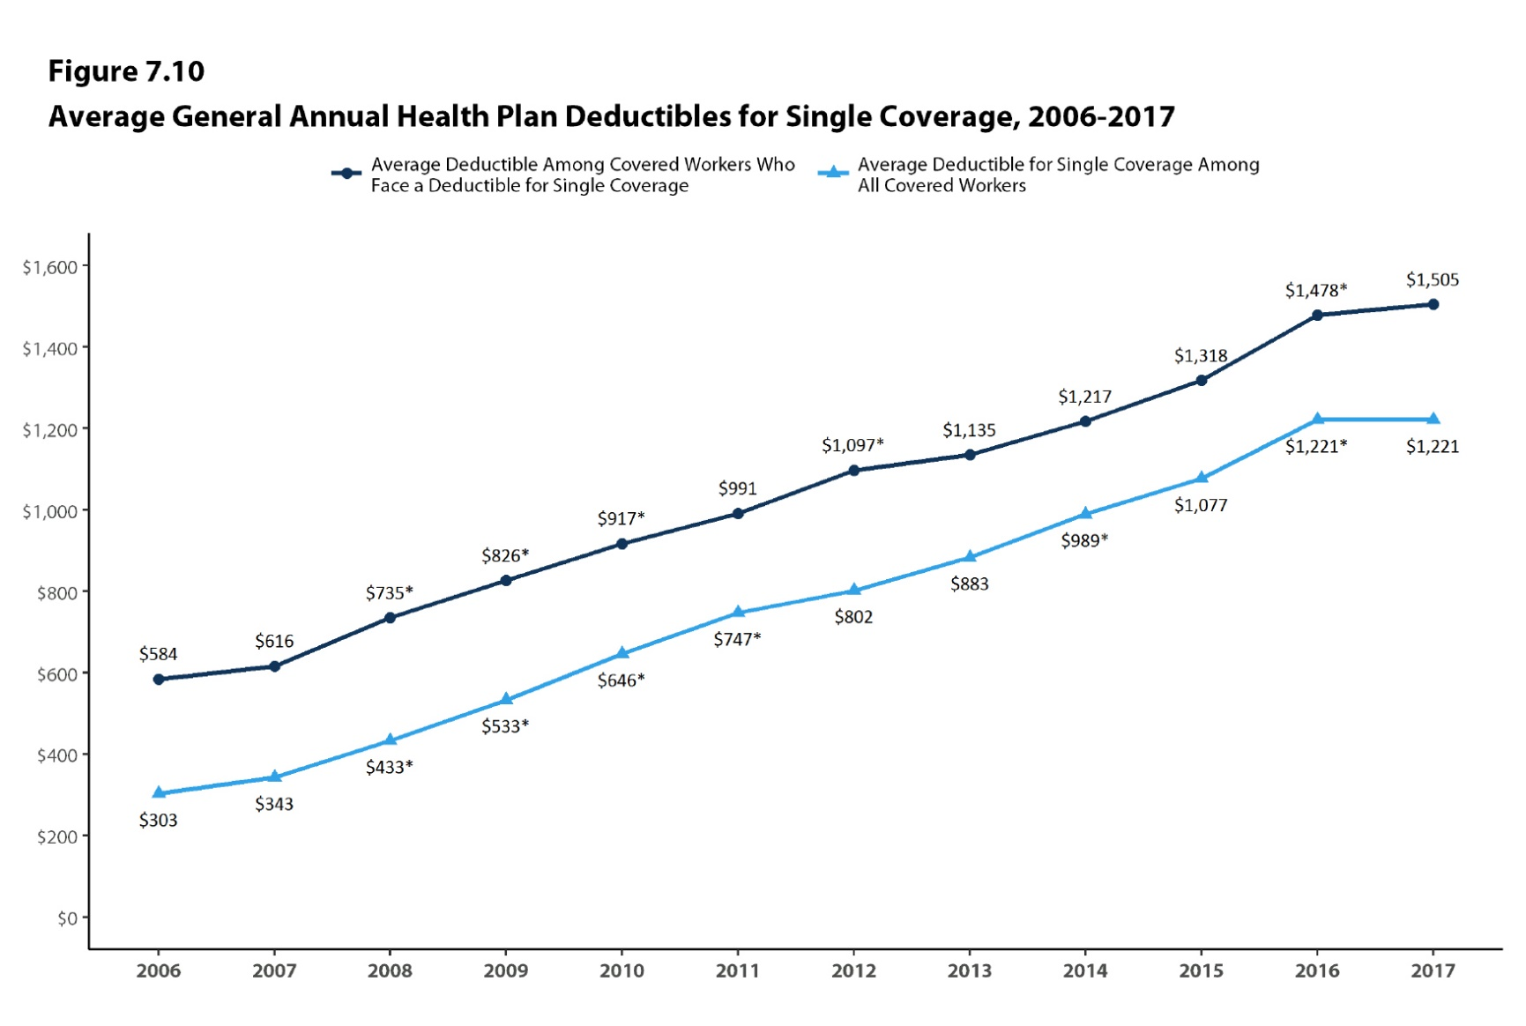

Slide 8
Healthcare Costs in Retirement are Increasing
Continuing a 12-year pattern, healthcare costs increased by $1,200+
Health-care dilemma: 10,000 boomers retiring each day
$285,000
2019
2018
$280,000
2017
$275,000
2016
$260,000
Milliman Medical Index calculates the total annual cost of healthcare for an American family of four covered by employer healthcare coverage.
A 65-year-old couple retiring this year will need an average of $285,000 to cover medical expenses throughout retirement, excluding long-term care expenses.
Source: 2018 Milliman Medical Index – May 2018
Source: Fidelity – April 2019
5/18 – 4/18
Notes:
A person who retires this year at age 65 can expect to spend around $285,000 for these items over the remainder of his or her lifetime. And this amount keeps going up each year. Where is this money going to come from?

Slide 9
Retiree Healthcare Expenses
Notes:
When people retire, they will continue to have medical expenses, but in most cases, they will no longer be covered by an employer health plan. Medicare does not cover all of these expenses. This chart shows what expenses retired people can expect to face that are not generally paid by Medicare or Medicare Supplement plans.

Slide 10
How did Congress Intend HSAs to Help

Slide 11
Policy Reasons for Congress to Authorize Health Savings Accounts
To provide an account similar to the very popular IRA to help pay health care costs after retirement.
Pro – Triple Tax Benefit
Con – The average American spends about 96% of their annual contribution to an HSA each year.
Make citizens better health care consumers.
Pro - Encourage individuals to take more responsibility for health care expenses
Con – People may delay getting needed medical care
Con – May lead to adverse selection problems
Shop around for best prices
Pro - Use market forces to reduce health care costs
Con – Health care costs lack transparency to the consumer

Slide 12
Why HSA is the Best Retirement Plan
Triple Tax Benefits
Federal tax deductions on contributions
Tax-free growth on invested funds
Tax-free withdrawals for qualified medical expenses
Other withdrawals taxed at current income tax rate
Notes:
This is one of the main reasons that Congress enacted the Health Savings Account legislation. Notice that Savings is in the title – its not Health Spending Account but Health Savings Account.
The best feature of an HSA is that it can be triple tax exempt – tax free when going in, no taxes on income – tax free when going out if used for qualified medical expenses.

Slide 13
The Power of Investing HSA Dollars for Future Healthcare Expenses
31% Increase in Healthcare Purchasing Power
Assumes:
$4,000 Annual Contribution Beginning at age 45
ROI of 5%
7.65% FICA tax savings on HSA contributions
25% combined federal and state tax rate
15% tax rate at time of distributions
Notes:
This chart compares the effectiveness of HSAs with after-tax Roth accounts and pre-tax 401(K) accounts in saving for retirement. As you look at this chart, it shows how incredibly powerful HSAs are as a vehicle to accumulate retirement savings.
This example uses a return on investment of 5%. That is very conservative. I personally have had just under 15% average return on the investment portion of my HSA since I started investing it 4 or 5 years ago.
How do you tap into that potential. By offering a quality investment package that people can use that is simple to operate, is low cost and doesn’t require any special investment expertise.

Slide 14
Getting Money Out of A Health Savings Account is Easy
This Photo by Unknown Author is licensed under CC BY-SA-NC

Slide 15
As Easy as Riding a Bike
By check
By Debit Card
By ATM or other cash withdrawal
Withdrawals are permitted:
For any purpose
Any time that there is money in the account

Slide 16
Taxes on HSA Withdrawals
If used to pay for qualifying medical expenses
If NOT used for qualifying medical expenses
No tax
If age 65 or older
Withdrawn amount is reported as ordinary taxable income
No penalty
If under age 65
Withdrawn amount is reported as ordinary taxable income
20% excise tax on amount withdrawn

Slide 17
Putting Money IN can be Complicated.

Slide 18
There are many rules.
Th individual must be Covered by a High Deductible Health Plan
Can Have no Disqualifying Coverage
Cannot be enrolled in Medicare
Must be age 18 or older
Cannot be eligible to be claimed as a dependent on someone else’s tax return
Subject to monthly contribution limits

Slide 19
Pros for Individuals
HSAs can be a potential retirement savings tool
Contributions are tax deductible
HSAs doesn’t expire and are fully portable (no use-it-or-lose-it)
Most HSA programs have an investment feature to increase long term growth
HSA balances offer flexibility to meet day-to-day needs and also save for long-term goals

Slide 20
Pros for Individuals
Can pay medical expenses of spouse and depedents, even if you have only single coverage
If you are self-employed or you work for a company that does not offer health benefits, HSAs may be the only way to deduct out-of-pocket medical expenses
HSAs are best for people with:
minimal or no medical expenses
people who can afford to pay their medical costs outside of the HSA

Slide 21
Cons for Individuals
To be eligible to make or receive contributions, an individual must be covered by a High Deductible Health Plan (HDHP) – 2024 Minimum deductible is $1,600 single and $3,200 for non-single. (Actual deductibles are typically much higher.)
The individual can have no other medical coverage that would pay for any medical expenses before these amounts are exceeded.
Out of pocket maximums can be as high as $8,050 for single coverage and $16,100 for non-single coverage in 2024

Slide 22
Cons for Individuals
It may take many years to accumulate a balance in an HSA that is large enough to cover a major unanticipated medical expense
HSAs can be a disaster for people with chronic illnesses or an imminent need for expensive medical care (such as having a baby)
The HSA account holder must keep permanent records for the IRS of all medical expenses paid with HSA withdrawals

Slide 23
Take Aways
HSAs are most beneficial for people who have the cash to fully fund their HSA each year and make withdrawals only in emergencies.
Personal financial risk is increased because of the high out-of-pocket cost limits of the HDHP

Slide 24
HSAs as an Employee Benefit

Slide 25
Should Employers Contribute to Their Employees’ HSAs?
Yes! But only if doing so satisfies the employer’s benefit objectives. (“Because my Benefits Advisor told me to is not a good reason.”)
What does the Employer want to accomplish?
Objectives may include such things as:
Providing additional retirement benefits for key employees
Helping employees pay for health expenses
Reducing health care budgeted costs
Shifting a greater share of health care expenses onto employees

Slide 26
Workplace HSA Program Pros-
Employer contributions are not taxable to the employee if the employer has a reasonable expectation that the employee is HSA “eligible”
Important to have all employees receiving HSA contributions to sign a certification that:
The Employee is HSA “eligible”
The Employee acknowledges that they understand the rules of the program and are solely responsible for keeping receipts and dealing with the IRS.

Slide 27
Workplace HSA Program Pros-
The Employer has no administrative responsibility beyond making contributions.

Slide 28
Workplace HSA Program Pros-
The plan is not subject to ERISA if the following rules are followed:
Employee contributions (if permitted) must be voluntary. An employer cannot require employee contributions.
Employers cannot restrict how employees use their HSA funds.
The employer can pick the HSA custodian but employees must be permitted to move funds to another HSA if they desire.
Employer cannot make or influence employee investment decisions
The employer cannot tell employees that the HSA Program is subject to ERISA
The employer cannot receive any direct or indirect compensation (such as discounts) in connection with its employees’ HSAs.

Slide 29
Workplace HSA Program Cons-
Withdrawals from HSAs cannot be restricted to payment of medical expenses.
Employee contributions to an HSA are after-tax (unless made through a Section 125 “cafeteria” plan)

Slide 30
Workplace HSA Program Cons-
Not all employees will be HSA “qualified”
What do employers do for employees who cannot receive an HSA contribution?
Some employers create two health benefit plans offering non-HDHP coverage for those employees or use an HRA or similar program for employees who are not HSA “qualified”

Slide 31
Workplace HSA Program Cons-
Compliance issues
Contribution limit rules are complex and easily violated
Employer contributions to employee HSAs are subject to discrimination testing
Is the employer’s HR department/payroll person willing or able to answer employee HSA questions? Should they?

Slide 32
Workplace HSA Program Cons-
HSAs are always fully vested and 100% portable.
If turnover is an issue, the employer will be paying the medical expenses of people who no longer work for that Employer from their HSA

Slide 33
Other Ways of Paying Employee Medical Expenses that are -
Tax deductible to the employer
Tax free to the employee
Examples we will look at:
EBHRA/HFSA Combo
ICHRA

Slide 34
EBHRA/HFSA Combo
No special group health policy required
Available to all employees eligible for employer coverage – actual coverage not required
Employer annual contributions are limited to $2,600 for 2024, but if the employer reduces its annual contribution to $2,100 or less it can match up to 100% of employee contributions instead
Employee contributions are limited to $3,200 for 2024
Employer may (but is not required to) permit carryover of unused amounts. HFSA carryover amounts are limited by law.
Employer may (but is not required to) forfeit the account balances of employees who leave employment

Slide 35
ICHRA
Employers provide tax free funds to reimburse employees for individual coverage (including premiums for Medicare and coverage purchased on the Exchange) if the employee is not eligible for group coverage.
Employee pre-tax contributions are limited to the part of the premium for individual coverage not paid by the ICHRA.
The employee can purchase an individual HDHP to become HSA qualified.
Provisions can be added to pay out-of-pocket medical expenses either with employer funds or employee pre-tax deposits to a HFSA.

Slide 36
Net Costs of Employer Contributions
 | HSA | Integratred HRA | HFSA
Employer Contribution Budget | $60,000 | $60,000 | $60,000
Typical Usage Percentage | 100% | 65% | 90%
Retained by Employer | $0 | $21,000 | $6,000
Actual Cost to Employer | $60,000 | $39,000 | $54,000
Notes:
This chart illustrates the true costs to an employer of funding HSAs rather than an HRA or FSA. Of course, every employer’s actual experience will be different, but these utilization rates are fairly common.
Utilization is somewhat higher for FSAs because they are typically funded primarily with employee contributions and most employees will try to clean out the account before the end of the year.

Slide 37
Takeaways from this Presentation
Health Savings Account are a good tool, but not the only tool – and not always the best tool – to attain an employer’s objectives.
HSAs tend to put the burden of rising out-of-pocket costs on the employee.
HSAs can be a great benefit for some employees but a financial disaster for others, particularly those with chronic health problems
To get the most benefit from an HSA, an individual must have sufficient funds to be able to substantially fund their HSA each year while paying for their out-of-pocket medical expenses with other funds.

Slide 38
Thank You
Reach us anytime!
We are here to help you.
Contact Fawn Wiebke at
(800) 383-1623
fawnw@advantageadmin.com
Advantageadmin.com

