Slide 1

Todd Holcomb, Ed.D. President

Slide 2
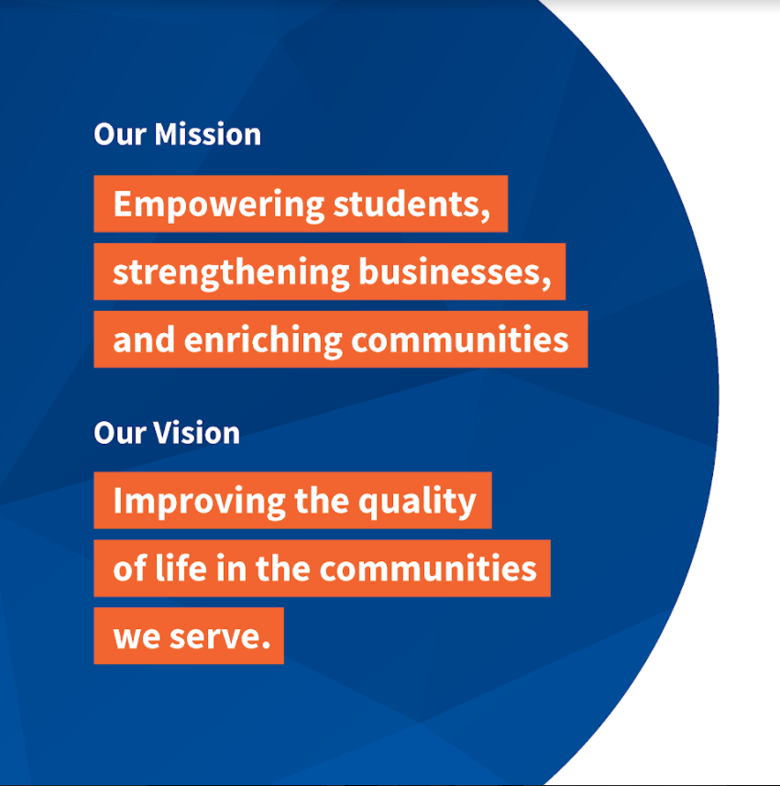
Notes:
Our Mission
Empowering students, strengthening businesses, and enriching communities
Our Vision:
Improving the quality of life in the communities we serve

Slide 3
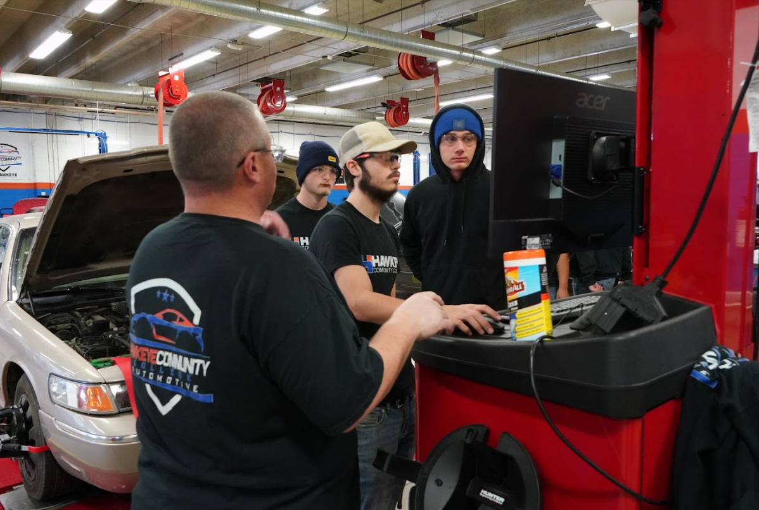
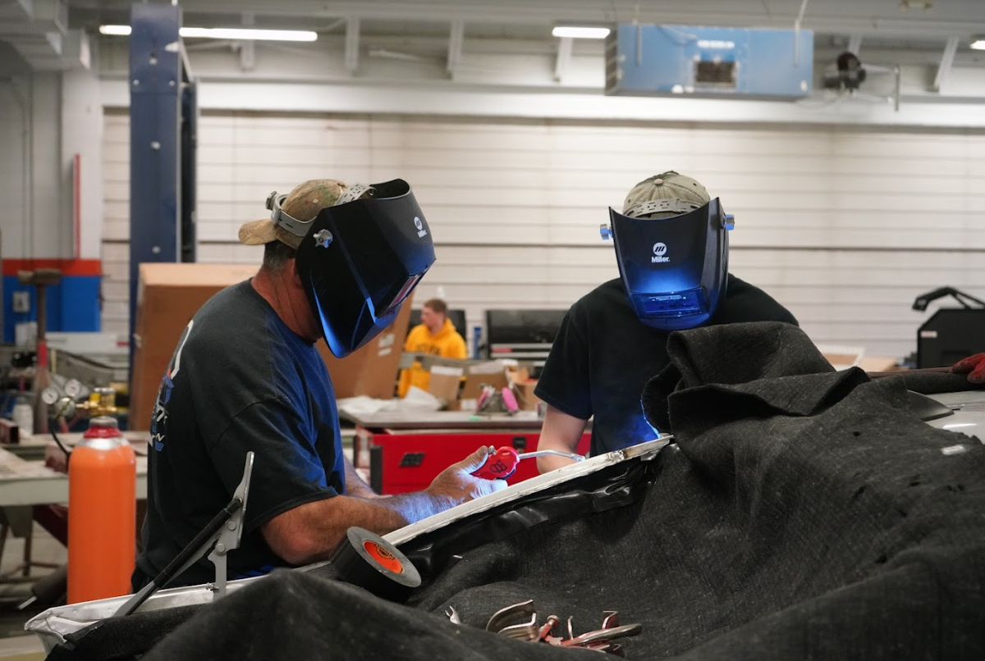
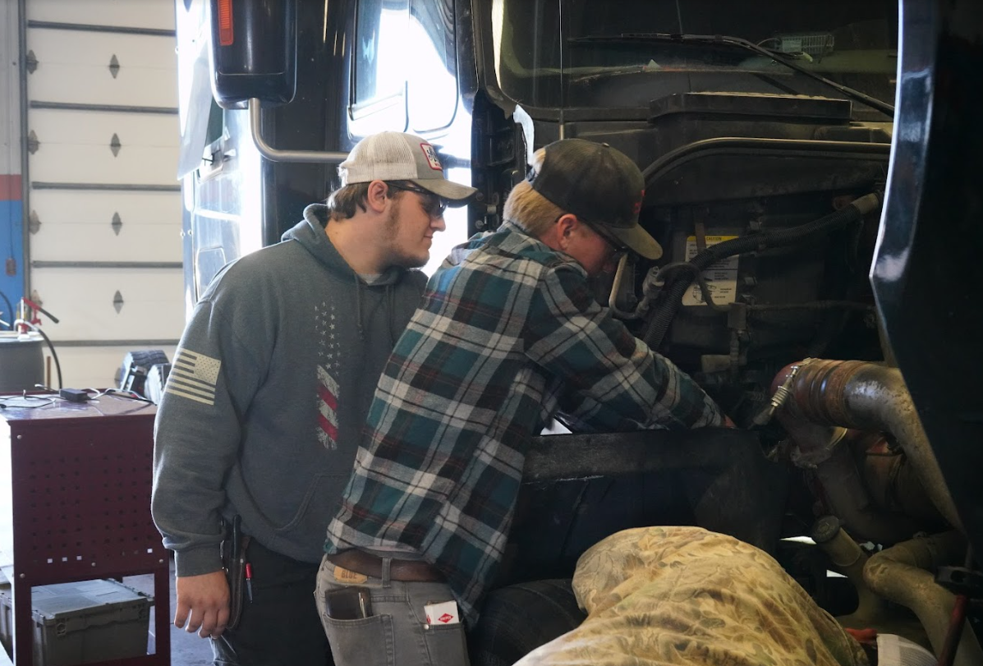
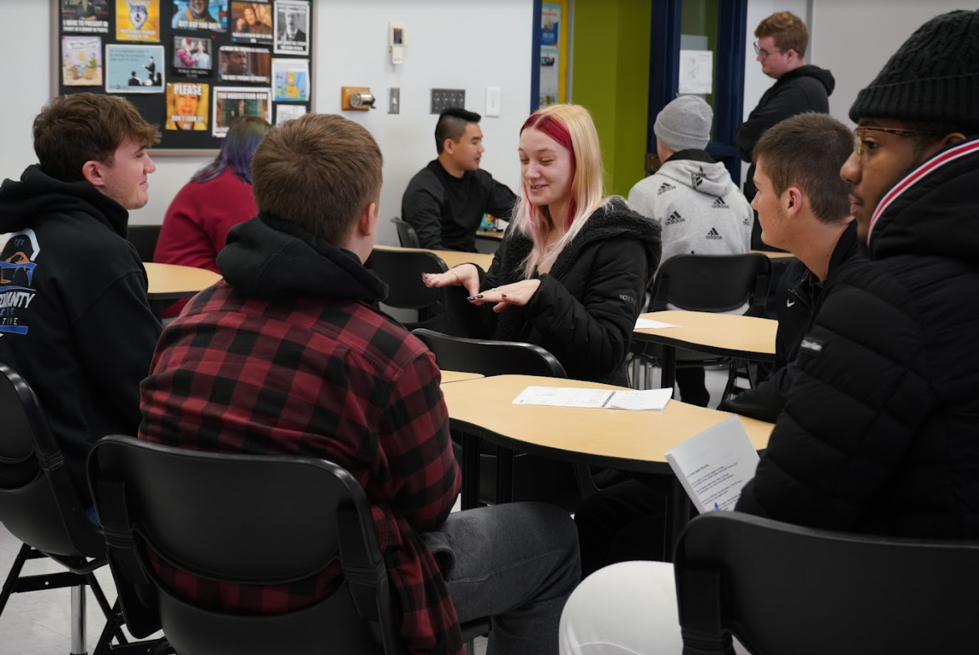
Building our Workforce
Notes:
Hawkeye offers:
Career and Technical Programs - provides immediate employment in a wide variety of careers.
Liberal Arts Transfer - provides arts and sciences courses that may be transferred to other colleges and university as the equivalent of the first two years of a four-year baccalaureate program.
Adult Education - provides part-time programs for adult students. Programs include: ESL (English as a second language), high school completion, supplementary career programs, and technical education for upgrading the skills of employed Iowans, and continuing education for those seeking pre-occupational preparation.
Short-term Training & Certification and Customized Business Training
Concurrent Enrollment

Slide 4
Hawkeye’s Impact
Serving 25,000 Individuals
92% of Students are from Hawkeye’s service area
Hawkeye’s Economic Impact to the Community is $444.5 Million or 6,343 Jobs
Hawkeye graduates earn $9,100 more each year compared to those with a high school diploma
Notes:
Serving 25,000 Individuals
92% of Students are from Hawkeye’s service area
Hawkeye’s Economic Impact to the Community is $44.5 Million or 6,343 Jobs
Hawkeye graduates earn $9,100 more each year compared to those with a high school diploma

Slide 5
Concurrent Enrollment – Career Academies
Hawkeye offers high school students the opportunity to earn college credit in high school - also known as concurrent enrollment.
25 School Districts
4,626 Students
$4.8 Million - Tuition savings to hard-working families
Notes:
Hawkeye offers high school students the opportunity to earn college credit in high school - also known as concurrent enrollment.
25 School Districts
4,626 Students
$4.8 Million - Tuition savings to hard-working families

Slide 6
Concurrent Enrollment – Career Academies
Fall 2022
Waverly-Shell Rock 322
Denver 133
Janesville 35
Sumner Fredericksburg 105
Tripoli 49
Credits Earned 4900
Tuition Saved $1,000,000

Slide 7
Training Partners
Hawkeye provides training for new businesses and expanding businesses
Training partners include:
Advanced Heat Corp, Waterloo
GMT Corporation, Waverly
Iowa Laser Technology, Cedar Falls
Kryton Engineering Metals, Cedar Falls
Jerald Sulky Company, Waterloo
John Deere, Waterloo
Nestle, Waverly
Tyson Fresh Meats, Waterloo
VGM Group, Waterloo
Viking Pump, Cedar Falls
Wapsie Creamery, Independence

Slide 8
Training Partners
Law Enforcement Agencies
Bremer County Sheriff’s Office
Waverly Police Department
Denver Police Department
Janesville Police Department
Tripoli Police Department
Sumner Police Department

Slide 9

Hawkeye Graduates
Hawkeye has graduated more than 50,000 students since 1966!
98%
of Hawkeye students are from Iowa
94%
of Hawkeye graduates stay in Iowa
Notes:
Hawkeye has graduated more than 50,000 students since 1966!

Slide 10

Athletics
Men’s Sports
Bowling
Cross Country
Dance
Esports
Golf
Soccer
Sports Shooting
Track and Field
Women’s Sports
Bowling
Cross Country
Dance
Esports
Golf
Soccer
Softball
Sports Shooting
Track and Field
Volleyball
Notes:
Hawkeye is RedTail proud offering athletics for men and women

Slide 11
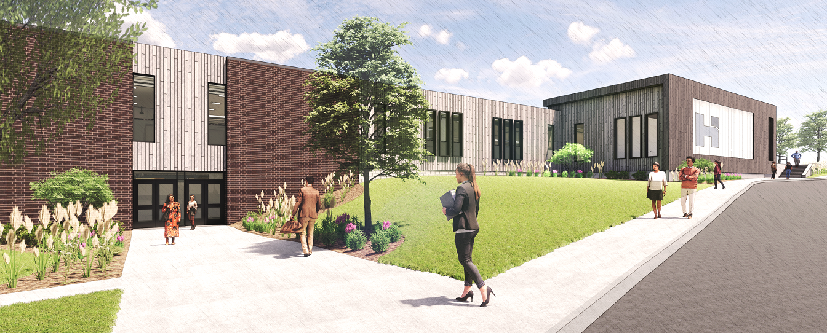
Grundy Hall
Notes:
Grundy Hall

Slide 12
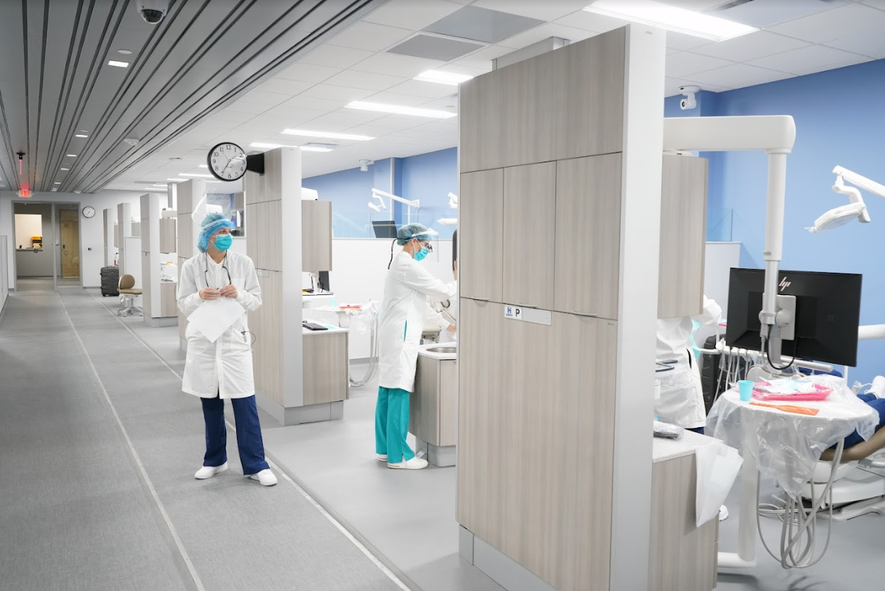
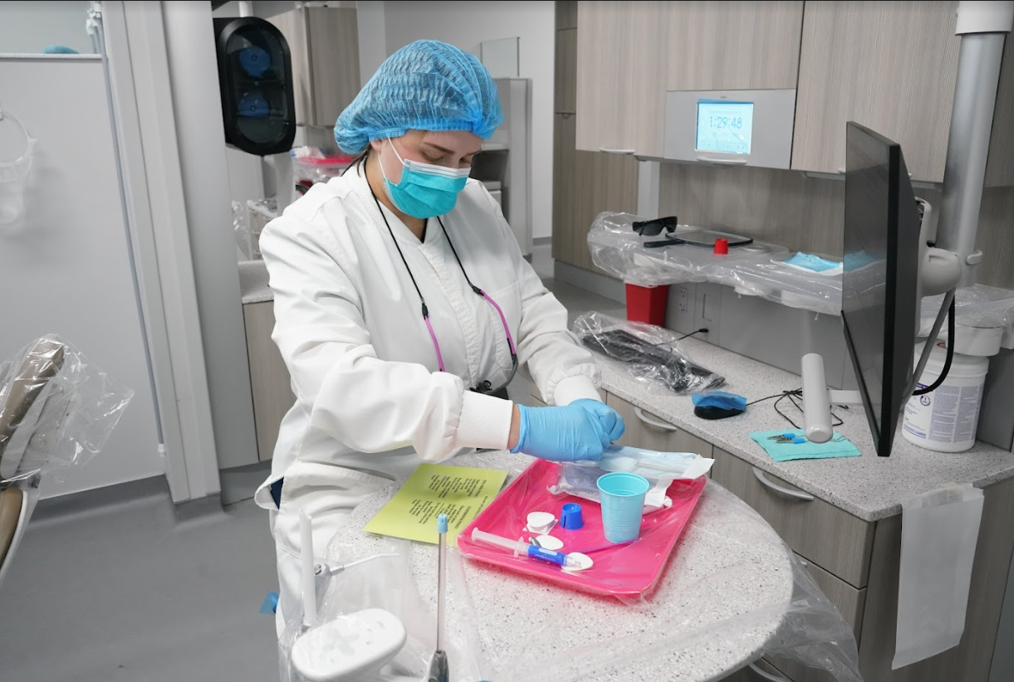
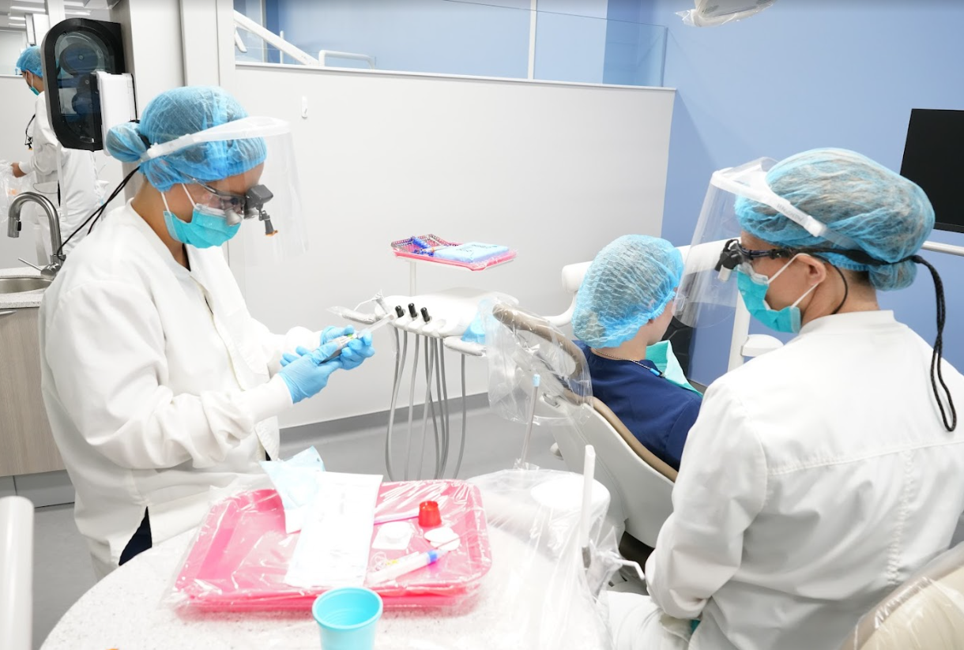
Notes:
Grundy Hall – pictures of dental clinic

Slide 13
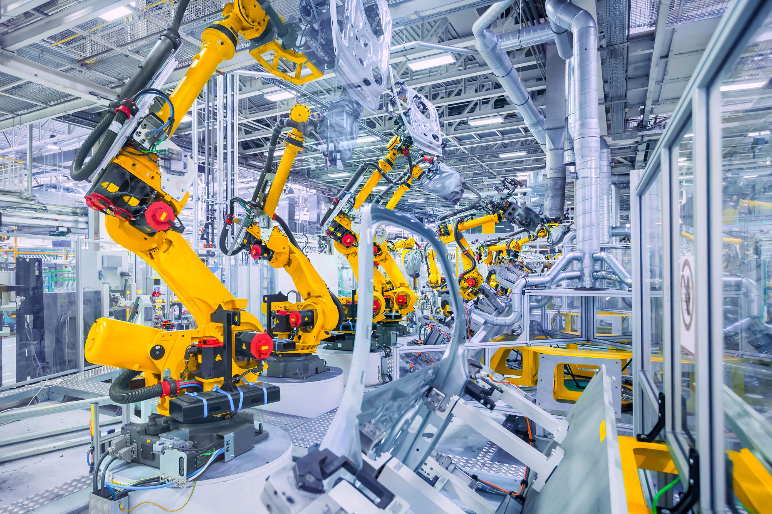
Automation and Robotics Center
Notes:
We are excited that we are currently in the process of creating an Automation and Robotics Center

Slide 14
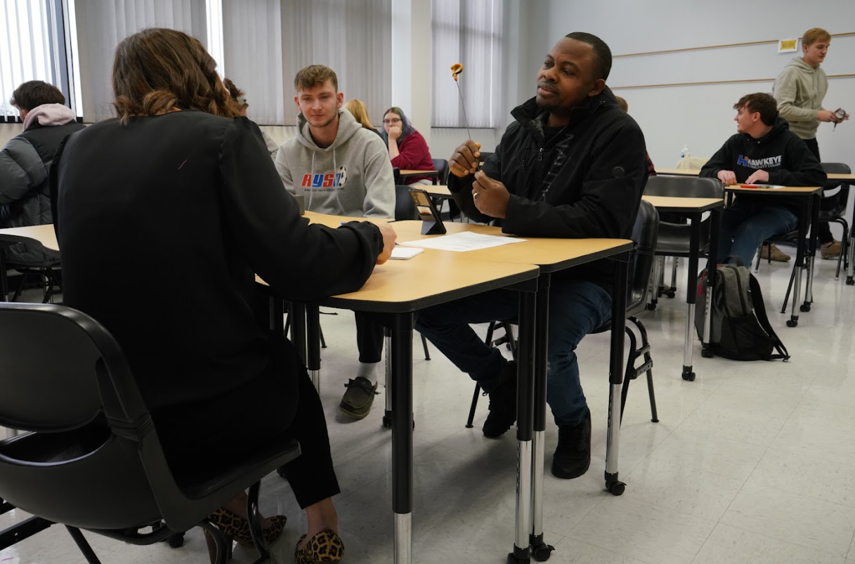
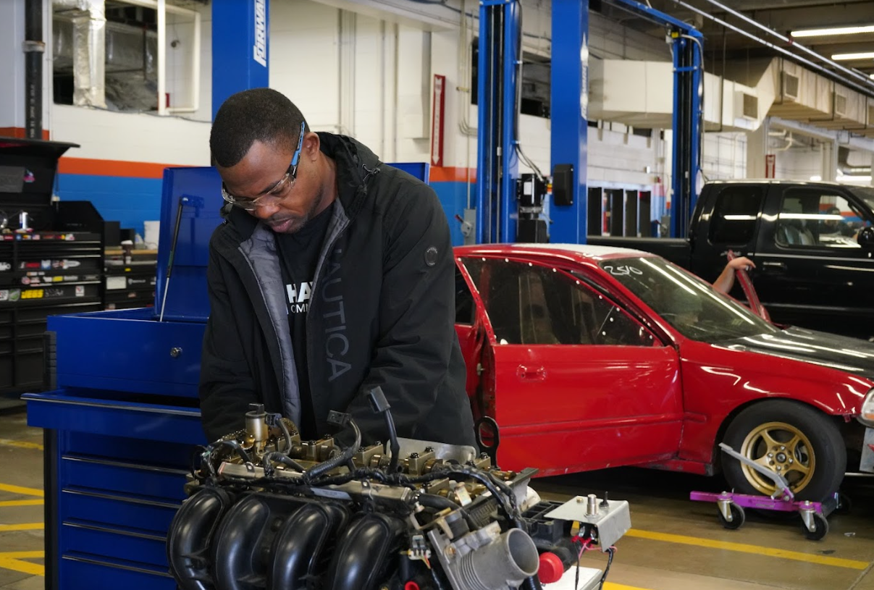
Planning for the Future
Skilled Trades and Apprentice Center
- Butler Hall Renovation and Expansion
Notes:
These are the projects identified as having the most impact to serve the needs of our communities
Skilled Trades and Apprentice Center
- Butler Hall Renovation and Expansion

Slide 15
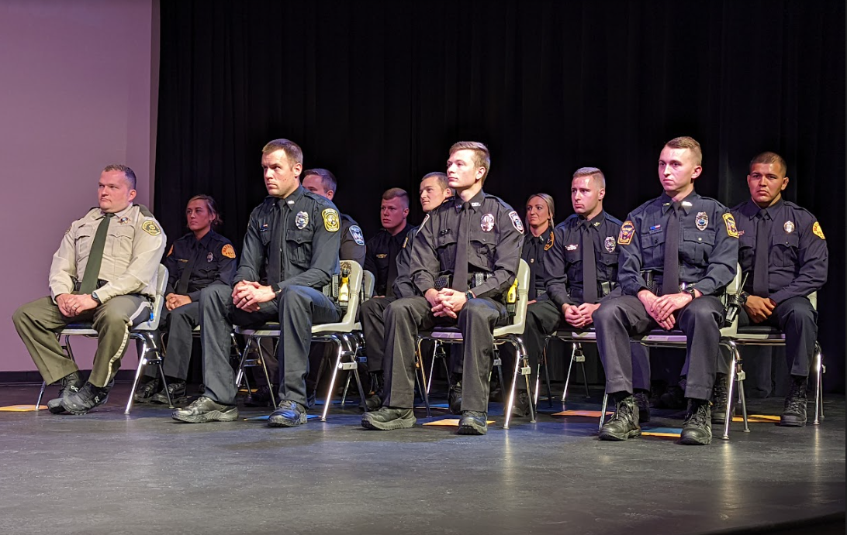
Planning for the Future
Expanded Law Enforcement Training Center
- Updated and Expanded Facilities Needed
Notes:
Expanded Law Enforcement Training Center
- Updated and Expanded Facilities Needed

Slide 16
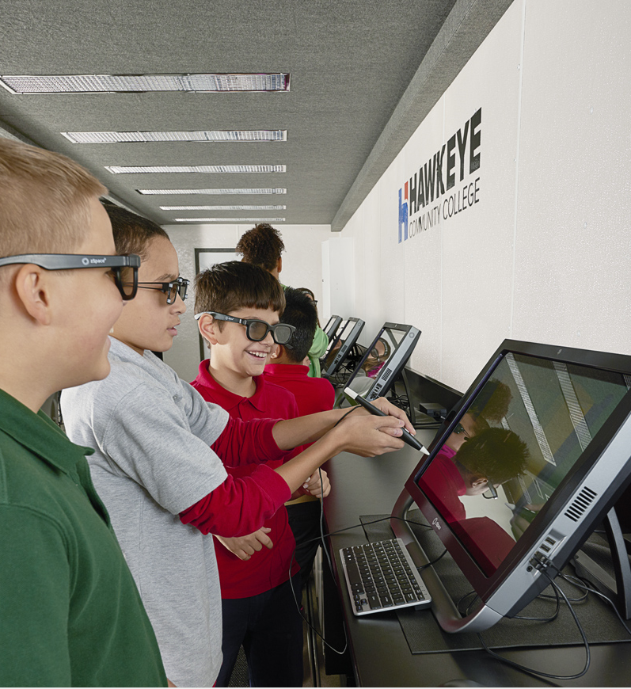
Planning for the Future
STEM Learning Center
- Bremer Hall Renovation
Notes:
STEM Learning Center
- Bremer Hall Renovation

Slide 17
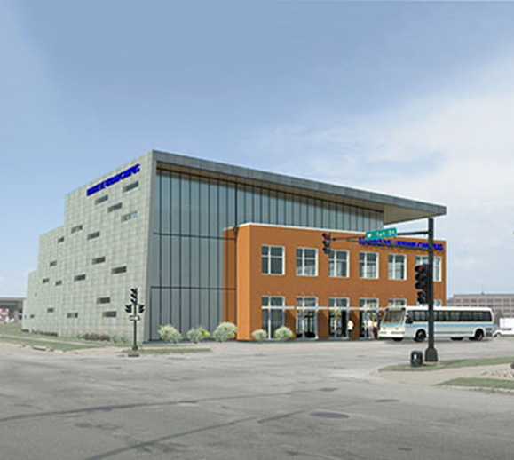
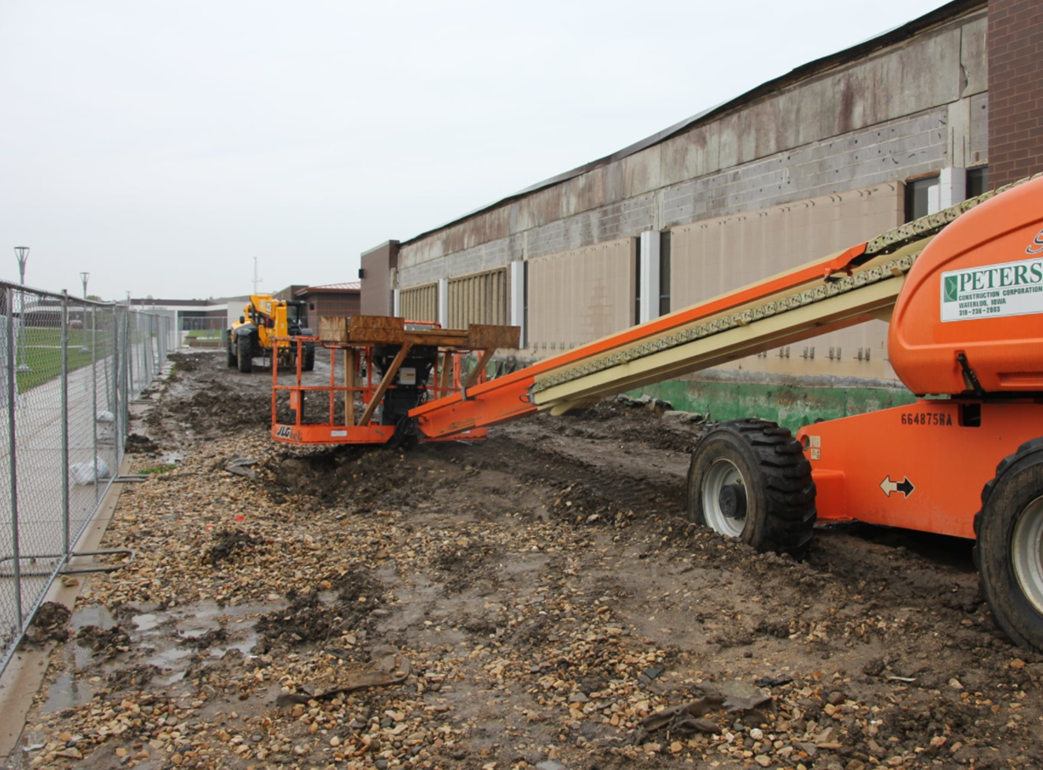
Community College facilities are funded by taxpayers in their service area
Tax Levy currently in place has funded:
-Van G. Miller Adult Learning Center
-Grundy Hall Renovation
Past funding:
Brock Student Center
Health Education and Services Center
Black Hawk Hall Addition
This levy has helped to move Hawkeye forward
in many ways and we appreciate the support!
Notes:
Unlike the Regents whose facilities are funded by the state - In Iowa, Community college facilities are funded by taxpayers in our service area. Currently, the college has a tax levy in place to pay for facilities - it is what has funded our Grundy Hall renovation and allowed the college to build the Van G Miller Adult Learning Center downtown.
Other projects in past projects include Brock Student Center
Health Education and Services Center
Black Hawk Addition
This levy has really helped the college move forward in so many ways - and we appreciate the community support.

Slide 18
On March 7, 2023 voters in Hawkeye’s service area overwhelmingly approved a $35 bond referendum with a 75.2% passage rate.
This was a renew of an existing levy, and the measure does NOT result in an increase in the bond and interest tax rate.
For a homeowner, continuance of the tax levy will cost approximately $1.20 per month based on a home valued at $100,000.
Notes:
On March 7, 2023 voters in Hawkeye’s service area overwhelmingly approved a $35 bond referendum with a 75.2% passage rate.
This was a renew of an existing levy, and the measure does NOT result in an increase in the bond and interest tax rate.
For a homeowner, the continuance of the tax levy will cost approximately $1.20 per month based on a home valued at $100,000.

Slide 19
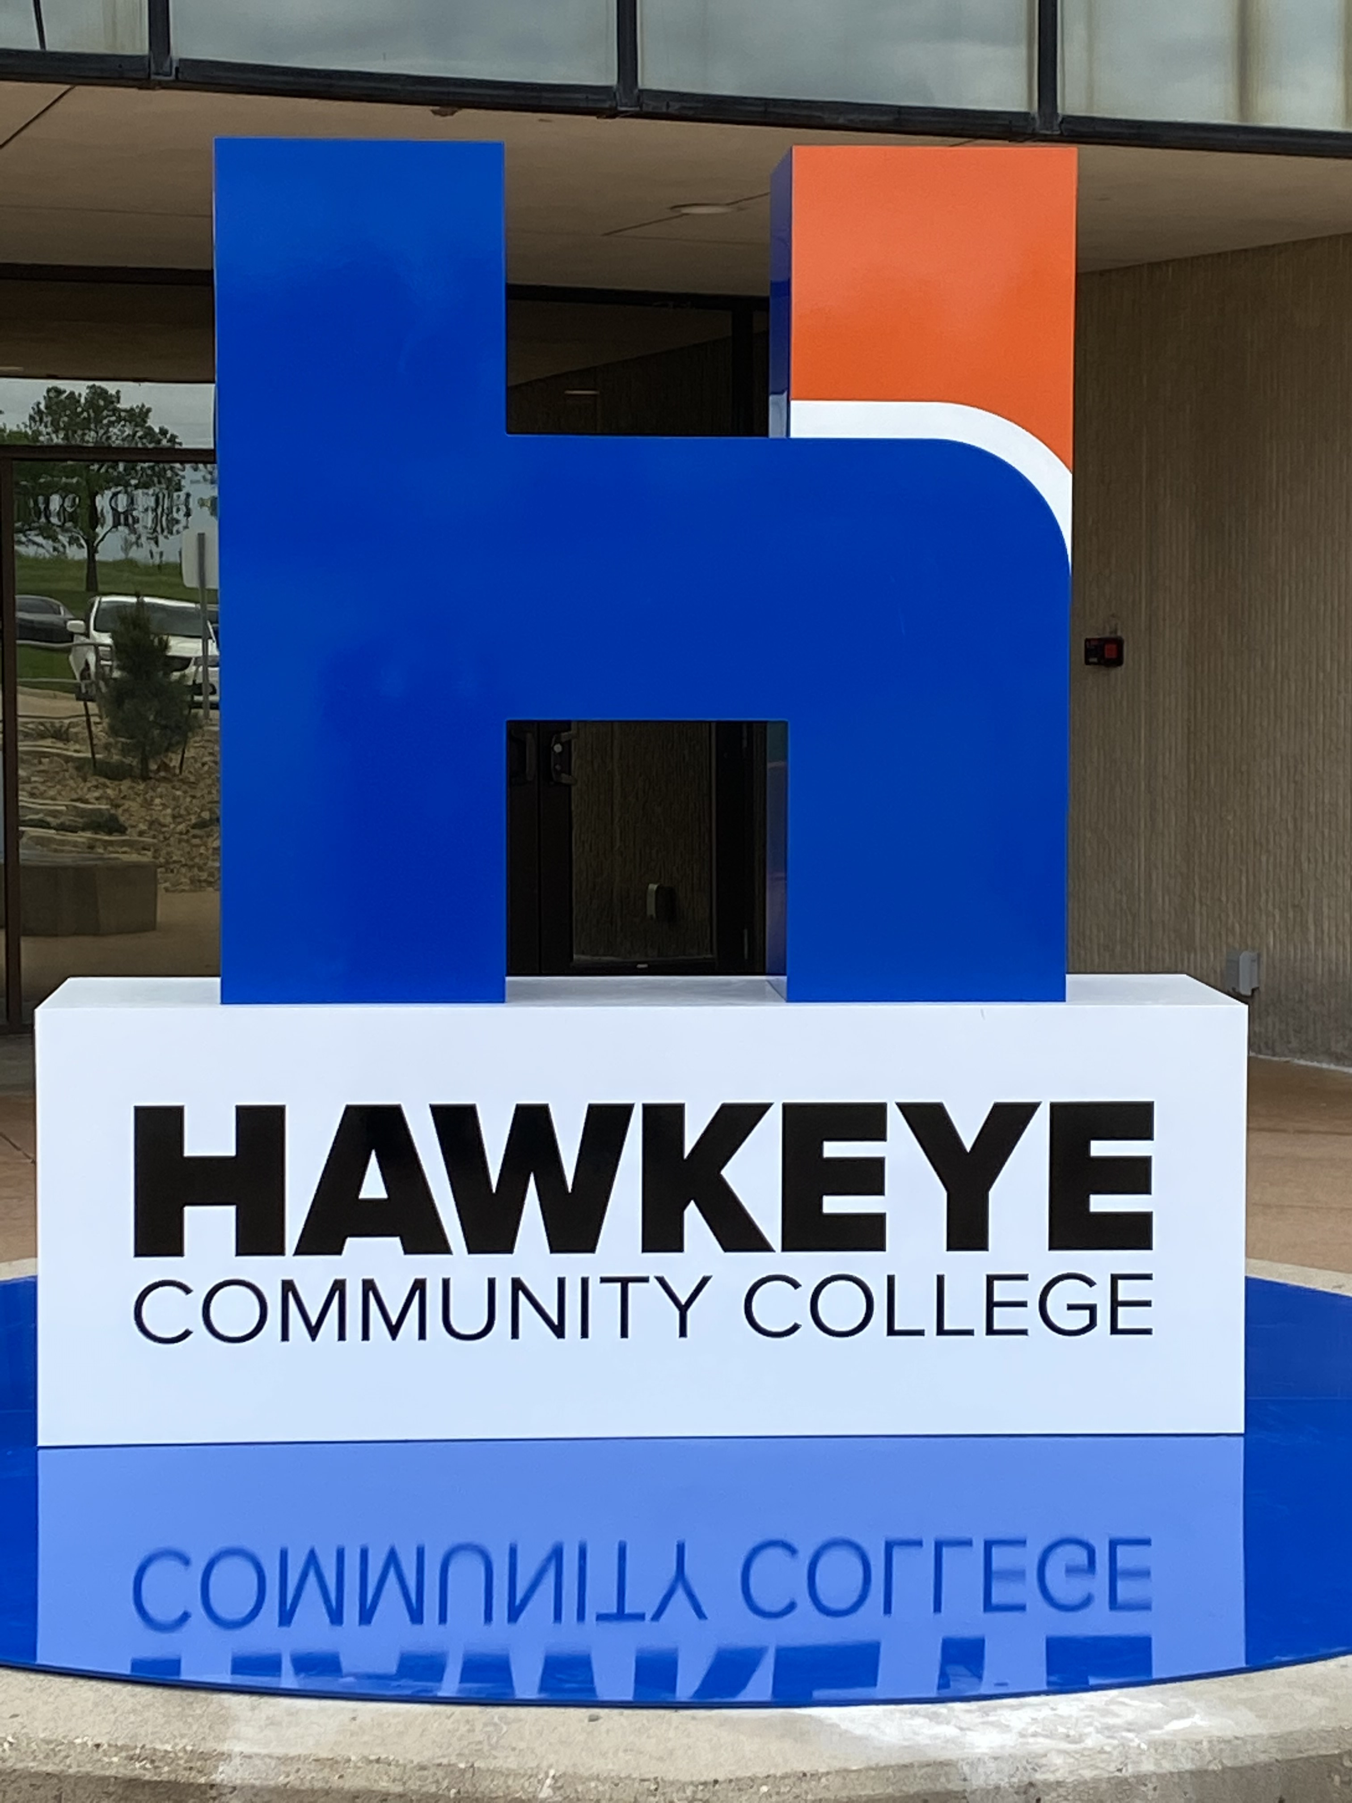
THANK YOU
for your support!

