Slide 1
The Future of Work
Curiosity, Adaptability, & Lifelong Learning
Robert Frederick, Director
UNI Career Services and Office of Student Employment

Slide 2
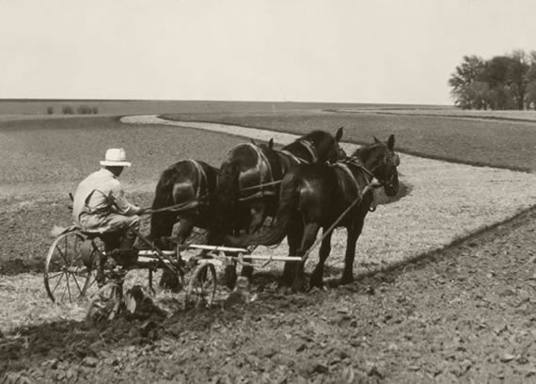
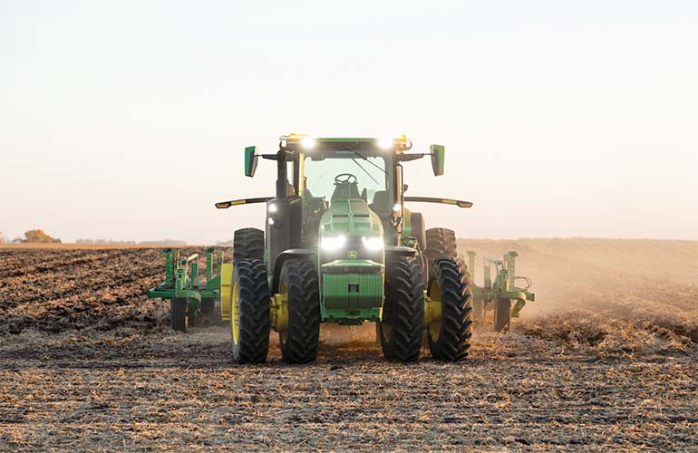
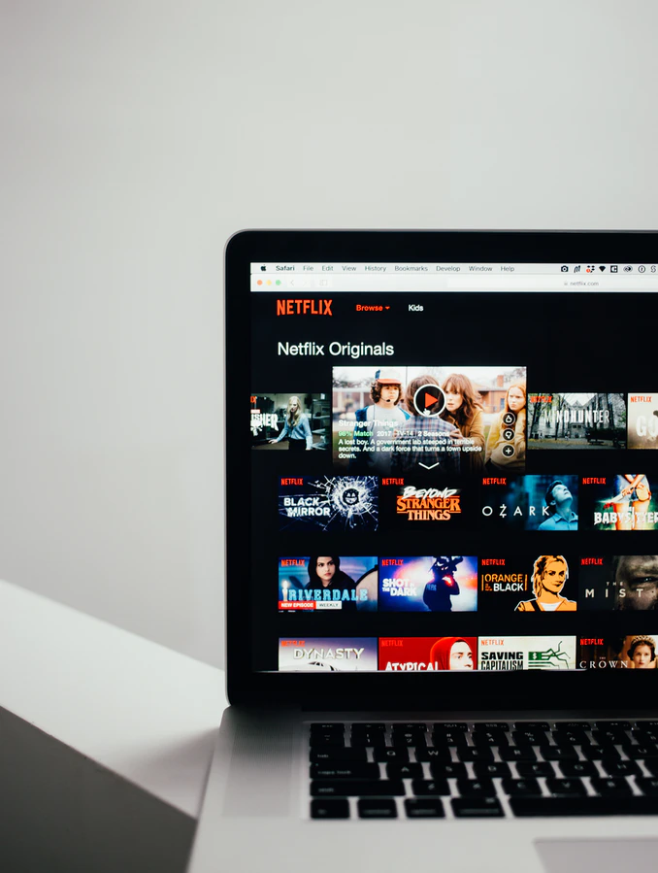
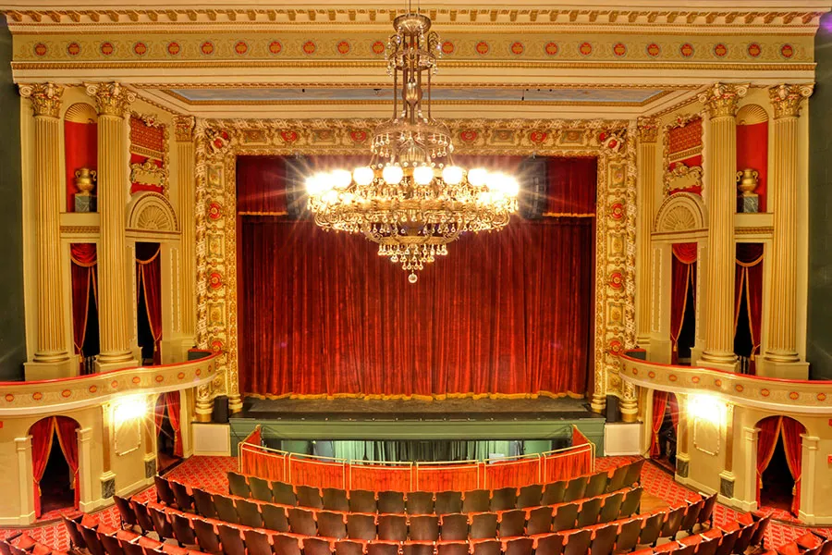
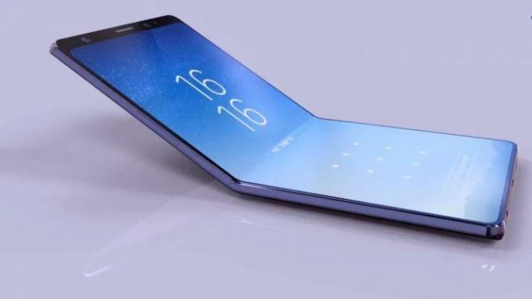
CONTEXT:
Buggy Whips
Daily Life
The Nature of Businesses

Slide 3
Future of Work:
From 14K to 100K job posting
“Up the down escalator” - Lifelong Learning
Automation - anything binary, repetitive, routine or algorithm capable
Intelligence Augmentation - not replacing you but enhancing you
Collaborative robots - COBOTS
Platforms rather than companies (Uber/YouTube) + monetized work vs. jobs
Alternative Work arrangements. Between 2010-2020, 88% of net new jobs came from Independent contractors & contingent labor
Distribution of work & distributed work models - “parts, pieces & people from everywhere”
“Jump Ball” - bid, proposal and contest work via crowdsourcing
No Racial or Ethnic Majority by 2045

Slide 4
Future of Work:
Disaggregated work & micro tasks = highly Fluid Workforce
AI - an existential threat and a transformational opportunity?
The Right to Disconnect -fundamental human right?
Tracking systems more closely monitoring all workers’ performance
Global Labor Force – remote work means workers from everywhere
The Human Economy (agrarian, industrial, service, human)
IOT – internet of things= big data and constant analytics (good data vs. big data)
High speed internet as a utility - water, gas, electric
Loss of real or perceived job security, benefits, retirement & organized labor - New Social Contract
Contingent Labor Companies - AQUENT, CREATIVE CIRCLE, UPWORK, FIVERR etc…

Slide 5
Future Employees:
Curiosity, Adaptability, & Lifelong Learning (CALL)
Core Competencies & Learning how to learn
Preparing for jobs that have not been invented yet
Learn from multiple platforms in an asymmetrical environment
Learn fast & on your own
“DRIVE” - Autonomy, mastery and purpose
Being tech-savvy is an essential skill for all
Not about logging hours – project-based work mentality
Earn & Learn world of work
Life Balance vs. Work-Life Balance

Slide 6
More Things I’m reading about….
Being human has great value - curiosity, imagination, innovation, empathy, love, compassion, sensing, feeling, laughing, crying...i.e not being a machine
Successful organizations will be designed and organized to maximize what humans are capable of thinking, creating, and doing in a world of machines
Evolving Perception of Higher Education - Earn & Learn is the future of everything work and education
Half-life of skill sets - Every Five Years
24% of millennials believe its normal to move every 2 years
WSJ & SHRM - Moving every 30 months increases life time earnings

Slide 7
“The future of work consists of learning a living.”
Marshall McLuhan
THANK YOU

